Slide 1
Deep Learning Frameworks
Intro to PyTorch and Training Models
Week 6 - Day 3

Slide 2
Why Use a Deep Learning Framework?
Writing everything from scratch is:
Time-consuming
Error-prone
Not scalable
Frameworks like PyTorch or TensorFlow:
Automate gradients
Optimize matrix operations
Manage models, layers, optimizers easily
Popular Frameworks:
PyTorch (developer-friendly)
TensorFlow (production-friendly)

Slide 3
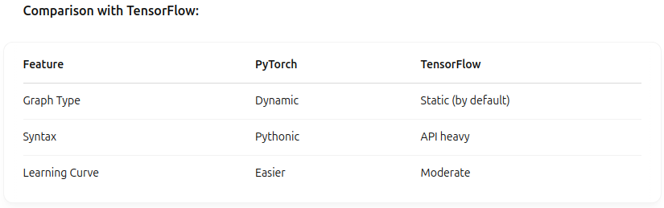
Why PyTorch?
Pythonic & intuitive
Strong community support
Dynamic computation graphs (easy debugging)
Widely used in academia and industry (Meta, OpenAI)

Slide 4
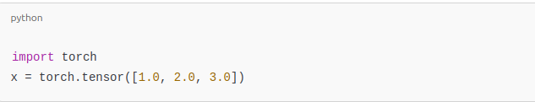
What is a Tensor?
A Tensor is the core data structure in PyTorch
Similar to NumPy arrays, but with added features (like autograd and GPU support)
Examples:
Scalar → 0D tensor
Vector → 1D tensor
Matrix → 2D tensor
Higher dimensions → Images, video, etc.

Slide 5
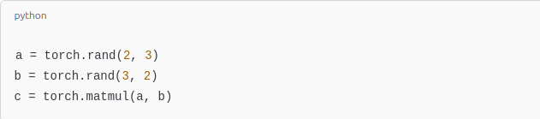
Tensor Operations
Operations you can perform:
Element-wise math
Matrix multiplication
Reshape, squeeze, unsqueeze
Transfer between CPU/GPU
Why tensors?
Efficient computation on both CPU and GPU!

Slide 6
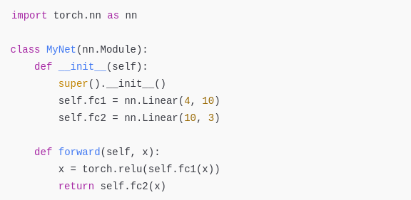
Building a Simple Neural Network
PyTorch provides torch.nn to build networks.
__init__() – Define layers
forward() – Define forward pass

Slide 7
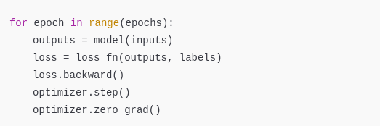
Training Loop Explained
Steps to train a model:
Forward pass – compute predictions
Compute loss
Backward pass – compute gradients
Update weights

Slide 8

Loss Functions
Common losses:
MSE Loss → for regression
Cross Entropy Loss → for classification

Slide 9

Optimizers
Optimizers update weights using gradients.
Popular ones: SGD, Adam
Call .step() to update weights
Call .zero_grad() to clear old gradients

Slide 10

Evaluation Mode vs Training Mode
Models behave differently during training and evaluation:
Dropout, batch norm, etc. work differently
Important for model validation & testing!

Slide 11
GPU Acceleration
Neural networks = Lots of matrix math
GPUs are optimized for parallel operations
Training on CPU: hours Training on GPU: minutes

Slide 12
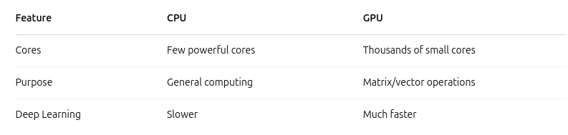
CPU vs GPU

Slide 13
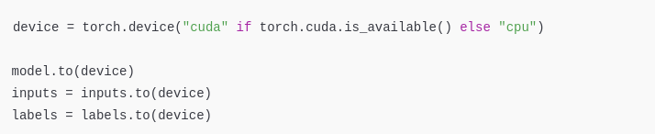
Using GPU in PyTorch

